Slide 1

OBJECT-ORIENTED PROGRAMMING
StringBuffer – StringBuilder StringTokenizer

Slide 2
Outline
StringBuffer
StringBuilder
String and StringBuffer
StringBuffer and StringBuilder
StringTokenizer
[503005 Lecture 3: String Buffer - String Builder]

Slide 3
StringBuffer
Java StringBuffer class is used to create mutable (modifiable) string. The StringBuffer class in java is same as String class except it is mutable i.e. it can be changed.
Java StringBuffer class is thread-safe i.e. multiple threads cannot access it simultaneously. So it is safe and will result in an order
[503005 Lecture 3: String Buffer - String Builder]

Slide 4
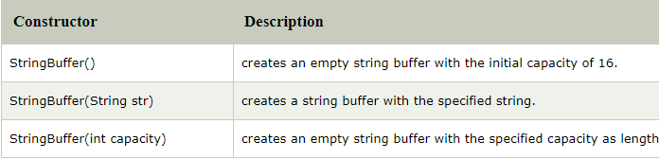
StringBuffer
Constructor:
[503005 Lecture 3: String Buffer - String Builder]

Slide 5
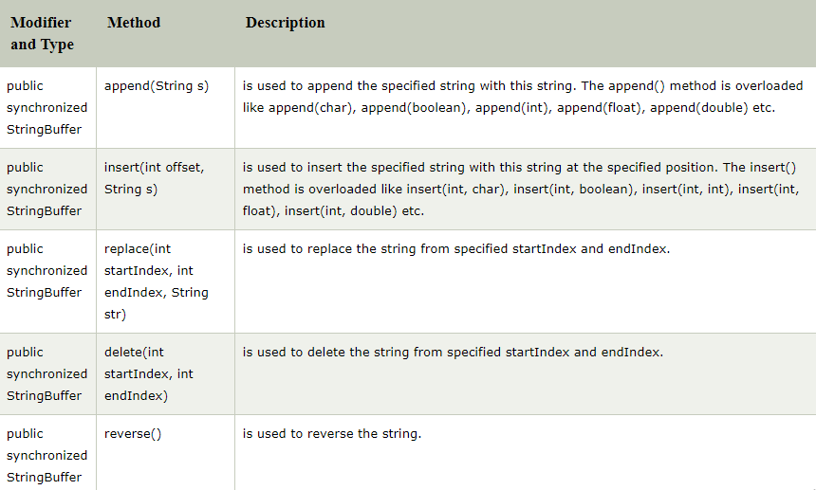
StringBuffer
Important methods
[503005 Lecture 3: String Buffer - String Builder]

Slide 6
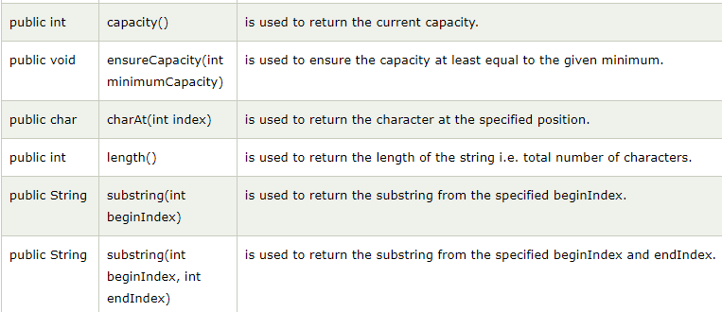
StringBuffer
Important methods
[503005 Lecture 3: String Buffer - String Builder]

Slide 7
StringBuffer
append()
class StringBufferExample{
public static void main(String args[]){
StringBuffer sb=new StringBuffer("Hello ");
sb.append("Java");//now original string is changed
System.out.println(sb);//prints Hello Java
}
}
[503005 Lecture 3: String Buffer - String Builder]

Slide 8
StringBuffer
insert()
class StringBufferExample2{
public static void main(String args[]){
StringBuffer sb=new StringBuffer("Hello ");
sb.insert(1,"Java");//now original string is changed
System.out.println(sb);//prints HJavaello
}
}
[503005 Lecture 3: String Buffer - String Builder]

Slide 9
StringBuffer
replace()
class StringBufferExample3{
public static void main(String args[]){
StringBuffer sb=new StringBuffer("Hello");
sb.replace(1,3,"Java");
System.out.println(sb);//prints HJavalo
}
}
[503005 Lecture 3: String Buffer - String Builder]

Slide 10
StringBuffer
delete()
class StringBufferExample4{
public static void main(String args[]){
StringBuffer sb=new StringBuffer("Hello");
sb.delete(1,3);
System.out.println(sb);//prints Hlo
}
}
[503005 Lecture 3: String Buffer - String Builder]

Slide 11
StringBuffer
reverse()
class StringBufferExample5{
public static void main(String args[]){
StringBuffer sb=new StringBuffer("Hello");
sb.reverse();
System.out.println(sb);//prints olleH
}
}
[503005 Lecture 3: String Buffer - String Builder]

Slide 12
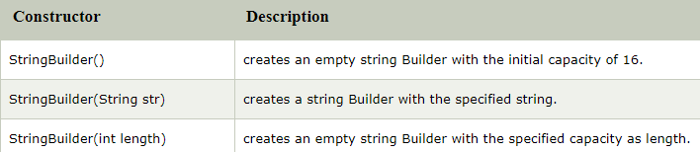
StringBuilder
Java StringBuilder class is used to create mutable (modifiable) string. The Java StringBuilder class is same as StringBuffer class except that it is non-synchronized. It is available since JDK 1.5.
[503005 Lecture 3: String Buffer - String Builder]

Slide 13
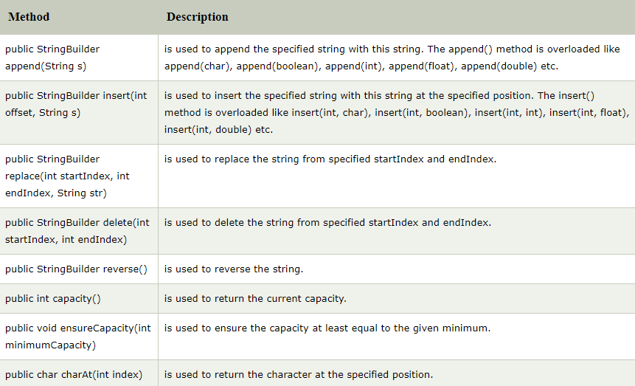
StringBuilder
[503005 Lecture 3: String Buffer - String Builder]

Slide 14
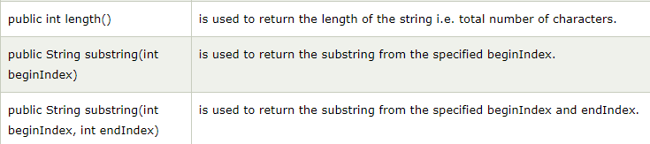
StringBuilder
The examples of StringBuilder class are similar to StringBuffer’s.
[503005 Lecture 3: String Buffer - String Builder]

Slide 15
Exercises
Use StringBuffer, StringBuilder and StringTokenizer to complete these requirement
Give a Vietnamese fullname (ex “Nguyen Van Teo”). Students need to write methods as follows:
Count how many words in the name.
Return a first name
Return a last name
Return a middle name
Capitalize the first character in each word of the name
Formailize the name, including:
Delete spaces in front and behind of the name.
Leave one space between the words of the name.
[503005 Lecture 3: String Buffer - String Builder]

Slide 16
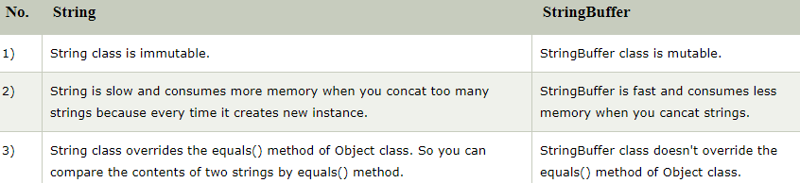
String and StringBuffer
There are many differences between String and StringBuffer. A list of differences between String and StringBuffer are given below:
[503005 Lecture 3: String Buffer - String Builder]

Slide 17
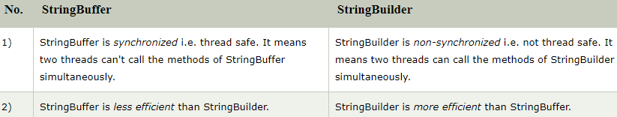
StringBuffer and String Builder
Java provides three classes to represent a sequence of characters: String, StringBuffer, and StringBuilder. The String class is an immutable class whereas StringBuffer and StringBuilder classes are mutable. There are many differences between StringBuffer and StringBuilder. The StringBuilder class is introduced since JDK 1.5.
A list of differences between StringBuffer and StringBuilder are given below:
[503005 Lecture 3: String Buffer - String Builder]

Slide 18
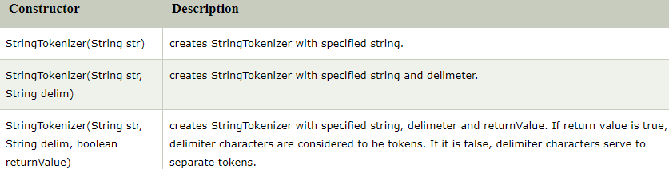
StringTokenizer
The java.util.StringTokenizer class allows you to break a string into tokens. It is simple way to break string.
[503005 Lecture 3: String Buffer - String Builder]

Slide 19
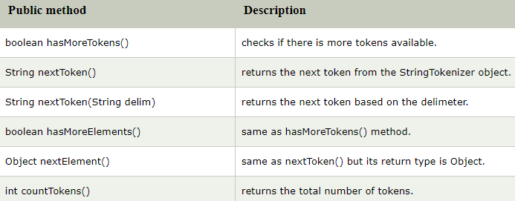
StringTokenizer
[503005 Lecture 3: String Buffer - String Builder]

Slide 20

StringTokenizer
import java.util.StringTokenizer;
public class Simple{
public static void main(String args[]){
StringTokenizer st = new StringTokenizer("my name is khan"," ");
while (st.hasMoreTokens()) {
System.out.println(st.nextToken());
}
}
}
[503005 Lecture 3: String Buffer - String Builder]

Slide 21
StringTokenizer
import java.util.*;
public class Test {
public static void main(String[] args) {
StringTokenizer st = new StringTokenizer("my,name,is,khan");
// printing next token
System.out.println("Next token is : " + st.nextToken(","));
}
}
[503005 Lecture 3: String Buffer - String Builder]

Slide 22
Exercises
Give a Vietnamese fullname (ex “Nguyen Van Teo”).
Using StringBuffer or StringBuilder or StringTokenizer to complete these exercises, Students need to write methods as follows:
Count how many words in the name.
Return a first name
Return a last name
Return a middle name
Capitalize the first character in each word of the name
Formailize the name, including:
Delete spaces in front and behind of the name.
Leave one space between the words of the name.
[503005 Lecture 3: String Buffer - String Builder]

Slide 23
End of file

